Slide 1
Provider Reporting
PRV 23.030

Slide 2
Informed consent for hysterectomy and sterilization
MetroPlusHealth Plan providers are required to comply with the New York City Department of Health and Mental Hygiene (DOHMH)informed consent guidelines in 42 CFR, Part 441, Sub Part F and 18 NYCRR Section 505.13. References: eCFR :: 42 CFR Part 441 Subpart F – Sterilizations, Title: Section 505.13 - Family planning. | New York Codes, Rules and Regulations (ny.gov). Providers who perform hysterectomies or other sterilization procedures are required to obtain informed consent from any patient undergoing a hysterectomy or other sterilization procedure.
Any facility that performs sterilizations must report all procedures online through Reporting Central on a monthly basis. Sterilization Reporting Guidelines (PDF)
DOHMH guidelines require members undergoing hysterectomies or sterilizations be notified verbally and in writing that the procedure will render them permanently sterile. Consent forms must be signed by the member or authorized representative. Providers must discuss the following with members at least thirty (30) days before the procedure is performed:
Member’s right to withdraw consent at any time prior to the procedure without jeopardizing any future treatment or federally subsidized benefit. | Full description of the associated risks, side effects, and discomforts (including those associated with any anesthesia to be used)
Alternative methods of family planning and birth control. | Full explanation of the benefits or advantages to be expected after undergoing the procedure.
Irreversibility of the sterilization procedure. | Explanation that the procedure will not be performed for at least thirty (30) days except in cases of premature delivery or emergency abdominal surgery.
Detailed and thorough explanation of the procedure to be performed.

Slide 3
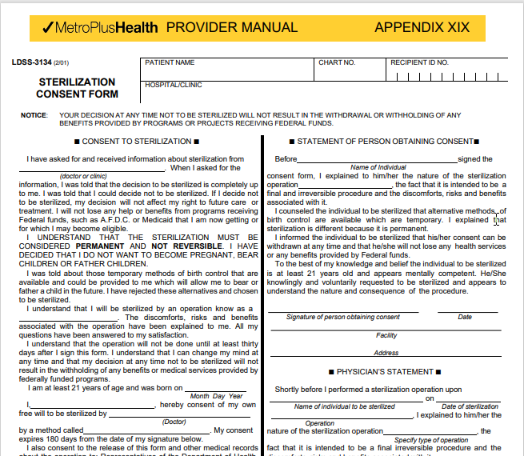
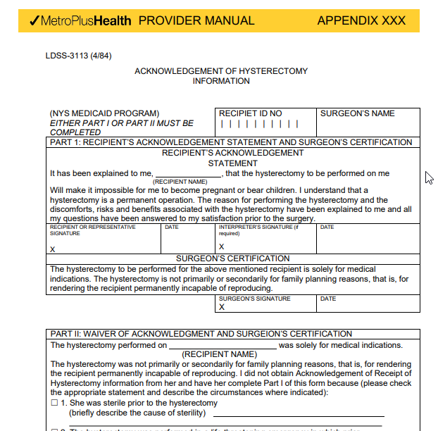
Informed consent for hysterectomy and sterilization
  MetroPlusHealth disseminates information regarding informed consent for hysterectomy and sterilization via provider orientation, provider manual, and MetroPlusHealth website.
  Hysterectomy and Sterilization forms are posted and available to providers on the MetroPlusHealth website Sterilization Consent Form (metroplus.org), Acknowledgement of Hysterectomy Information (metroplus.org)) and provider manual.

Slide 4
Reportable communicable diseases and conditions
What are Reportable Communicable Diseases and Conditions?
  MetroPlusHealth providers are required to comply with New York Department of Health (NYSDOH) protocols and regulations for the evaluation, treatment, and reporting of sexually transmitted diseases, communicable diseases, tuberculosis, immunizations, lead poisoning, suspected child abuse cases, and developmental delay or disability for early intervention services. For more information go to: www.health.ny.gov/professionals/diseases/reporting/communicable/
Communicable Disease Reporting
    Providers have a critical role in the prompt reporting of communicable diseases and can make the difference between disease control and an outbreak.
    Reports should be made to the local health department in the county in which the patient resides and need to be submitted within 24 hours of diagnosis. However, some diseases warrant prompt action and should be reported immediately to local health departments by phone. A list of diseases and information on properly reporting them can be found under Communicable Disease Reporting Requirements.
    For more information on communicable disease reporting, call your local health department or the New York State Department of Health's Bureau of Communicable Disease Control at (518) 473-4439 or, after hours, at 1 (866) 881-2809; to obtain reporting forms (DOH-389), call (518) 402-5012.
    In New York City, call 1 (866) NYC-DOH1 (1-866-692-3641) for additional information. Health care personnel in New York City should use the downloadable Universal Reporting Form (PD-16) ; those belonging to NYC MED can create an account, complete and submit the form online .

Slide 5
Reportable communicable diseases and conditions
  Communicable Disease Reporting
    HIV/AIDS reporting requirements vary from other communicable disease reporting. A complete description of these requirements can be found at http://www.health.ny.gov/diseases/aids/regulations/, or further information may be obtained by calling (518) 474-4284.
Early Intervention Reporting
    The Early Intervention Program helps young children (birth to 3 years) who are not learning, playing, growing, talking or walking like other children their age. The earlier in life a child starts our program, the sooner they can learn the skills they need.
    Health care providers should make referrals by calling 311 and asking for Early Intervention, or by filling out the Early Intervention Program Referral Form (PDF) and faxing it to the regional office in the child’s borough of residence.
    Suspected Child Abuse/Neglect Reporting
    Mandated reporters: Certain professionals such as doctors, nurses, teachers, police officers, and child care center workers are mandated by New York State law to report suspected child abuse and neglect to the state hotline, the New York State Central Register (SCR).
    Mandated reporters should call 311 in NYC or call the SCR's Mandated Reporter hotline directly at 1(800) 635-1522. If the child is in immediate danger, call 911.
    Suspected cases of child abuse (use Report of Suspected Child Abuse or Maltreatment LDSS-2221A)

Slide 6
Preventive Health Care Guidelines
What are Preventive Health Care Guidelines?
  MetroPlusHealth has adopted preventive health care guidelines for Participating Providers’ use in the following healthcare domains:
  General Adult Health
  Women’s Health
  Pregnant Women’s Health
  Children’s Health
Each of the guidelines describes prevention or early detection interventions, recommended frequency and conditions under which the interventions are required.
Preventive care services included in the guidelines are based on recommendations from: U.S. Preventive Services Task Force, Centers for Disease Control and Prevention (CDC), Health Resources and Services Administration (HRSA) and the latest medical research from organizations like the American Medical Association.
Where can Providers Access Preventive Health Care Guidelines?
  MetroPlusHealth’s Preventive Health Care Guidelines can be found on the provider website and provider manual.

Slide 7
Clinical practice guidelines
What are Clinical Practice Guidelines (CPGs)?
  MetroPlusHealth adopts and disseminates evidence-based guidelines for the provision of acute and chronic care services relevant to our population in all product lines.
  Clinical practice guidelines serve as a decision support tool for our contracted providers and members.
  Adopted guidelines are reviewed by MetroPlusHealth’s Quality Management Department using resources such as the Agency for Healthcare Research and Quality (AHQR), U.S. Preventive Services Task Force (USPSTF), American College of Cardiology (ACC) and the American Diabetes Association (ADA).
  Clinical Practice Guidelines are updated when national guidelines change, but no less than every two years.
Where can Providers Access CPGs?
  Providers and members may access them via the MetroPlusHealth Provider Manual, provider orientations, MetroPlusHealth website (contains the most updated guidelines). They are also available in print upon request. Providers can contact the Provider Services Call Center at 1.800.303.9626.

Slide 8
Early Periodic Screening Diagnosis & Treatment (EPSDT)/ Child/Teen Health Program (C/THP) Requirements
The EPSDT benefit provides comprehensive and preventive health care services for children under age 21 who are enrolled in Medicaid. EPSDT is key to ensuring that children and adolescents receive appropriate preventive, dental, mental health, developmental, and specialty services
Screening Services
Diagnostic Services
Treatment
Screening Services
Comprehensive health and developmental history – (including assessment of both physical and mental health development)
Immunizations in accordance with the most current New York State or New York City Recommended Childhood Immunization Schedule, as appropriate. (Resource for updates: NYS DOH Immunization Program).
Comprehensive unclothed physical exam
Laboratory tests as specified (including lead toxicity screening)
Health Education (anticipatory guidance including child development, healthy lifestyles, and accident and disease prevention)
Vision Services
Dental Services
Hearing Services
When a screening examination indicates the need for further evaluation of an individual’s health, provide diagnostic services or refer when appropriate.
Any necessary referrals and follow-up should be made without delay to make sure that the Medicaid member receives a complete diagnostic evaluation.
Provide treatment or other measures (or refer when appropriate) to correct or ameliorate defects, medical conditions, or mental illness discovered by screening services.

Slide 9
Early Periodic Screening Diagnosis & Treatment (EPSDT)/ Child/Teen Health Program (C/THP) Requirements
State Program Guidelines
Periodicity Schedule
Developmental & Behavioral Screening
Lead Screening
Inform all Medicaid-eligible individuals under age 21 that EPSDT services are available and of the need for age-appropriate immunizations;
Provide or arrange for the provision of screening services for all children;
Arrange (directly or through referral) for corrective treatment as determined by child health screenings; and
Report EPSDT performance information annually via Form CMS-416
Providers must follow the most current version of the American Academy of Pediatrics (AAP): Recommendations for Preventive Pediatric Health Care – Bright Futures/American Academy of Pediatrics. https://brightfutures.aap.org/Pages/default.aspx
Periodic developmental and behavioral screening during early childhood is essential to identify possible delays in growth and development.
These screenings are required for children enrolled in Medicaid and are also covered for children enrolled in CHIP.
This CMS Fact Sheet describes CMS resources to support states in ensuring enrolled children receive these screenings.
While substantial environmental improvements have been made to reduce exposure to lead, there are still over 4 million children estimated to reside in housing where they are exposed to lead.
Learn more about Medicaid lead screening policy.
Note: For further information about the Program: NEW YORK STATE DEPARTMENT OF HEALTH (emedny.org)

Slide 10
Child and Adolescent Immunizations
MetroPlusHealth recommends using the 2023 Recommended Child and Adolescent Immunization Schedule for members 18 years and younger: 0-18yrs-child-combined-schedule.pdf (cdc.gov)
  ACIP (The Advisory Committee on Immunization Practices) developed immunization schedules for children, adolescents and adults in which recommendations are given to aid in the prevention of vaccine preventable diseases.
  The Centers for Disease Control and Prevention (CDC) recommends routine vaccination to prevent 17 vaccine-preventable diseases that occur in infants, children, adolescents, or adults.

Slide 11
Reporting Immunizations Requirements
What are the Immunization Reporting Requirements?
NYC health care providers report immunizations to the CIR as mandated by New York State Public Health Law and the NYC Health Code.
All immunizations given to people ages 18 years or younger must be reported within 14 days to the Citywide Immunization Registry (CIR). You may also voluntarily report immunizations for older patients to CIR, but that is not required.
Reporting of all administered COVID-19 vaccine doses to the CIR is required within 24 hours of administration, as specified by the NYS Department of Health and in the COVID-19 Vaccination Provider Agreement.
How do Providers Report?
  There are two ways to exchange immunization data with the CIR:
  Electronically through your EHR: https://www.nyc.gov/site/doh/providers/reporting-and-services/cir-how-to-report.page
  Online with the CIR’s Online Registry: http://www.nyc.gov/health/cir

